Slide 1
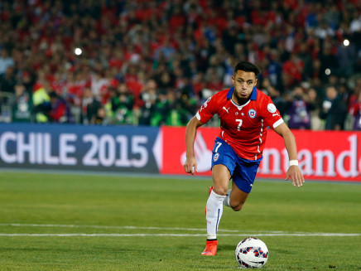
The penalty game
Complete the sentence with the correct modal verb and make a goal.

Slide 2


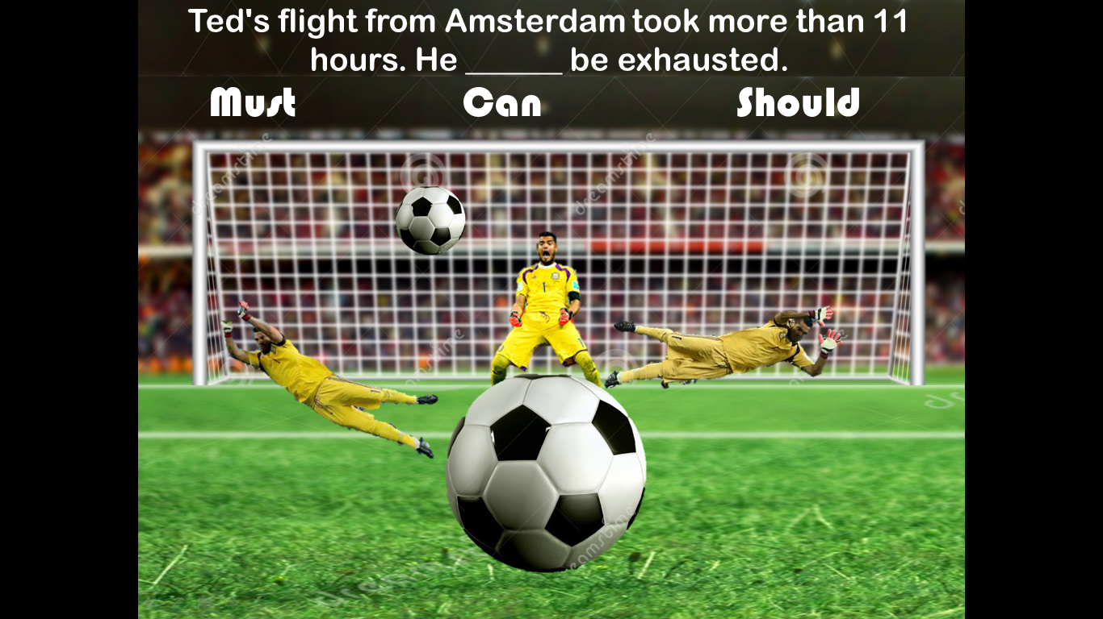
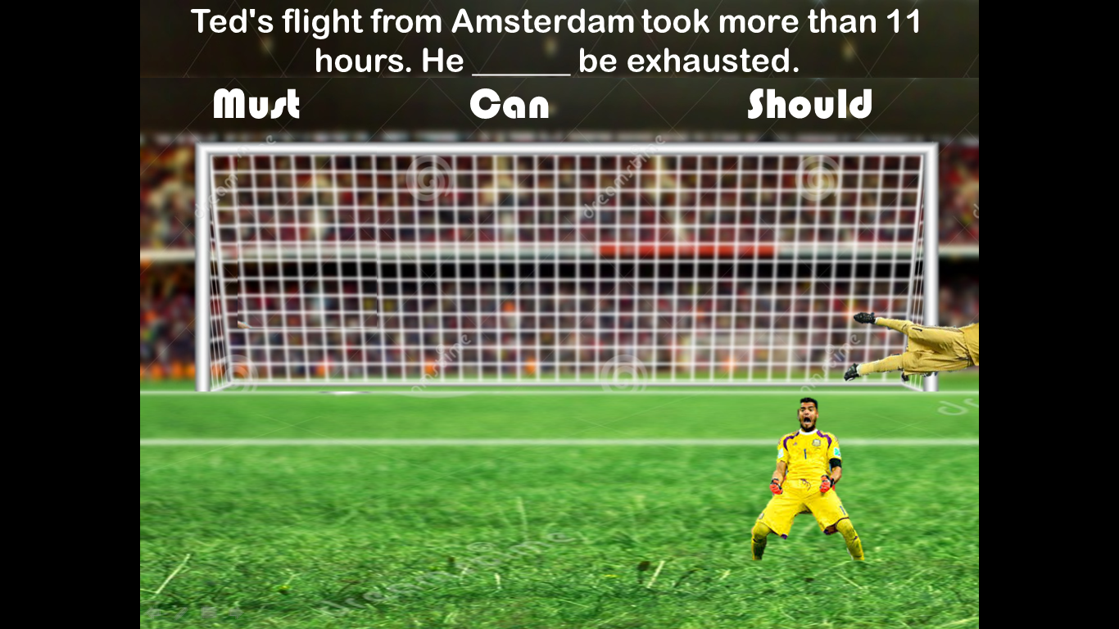

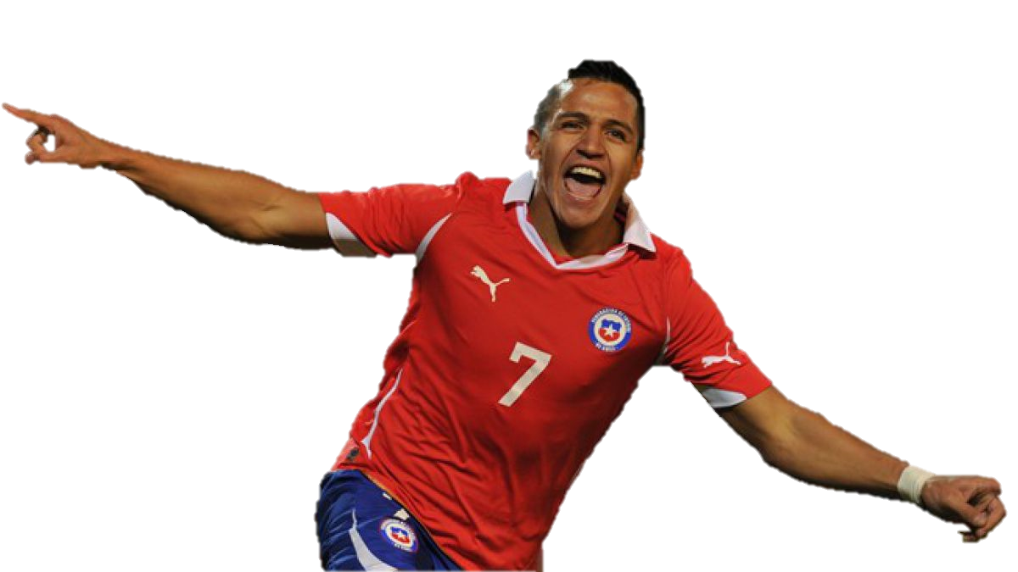

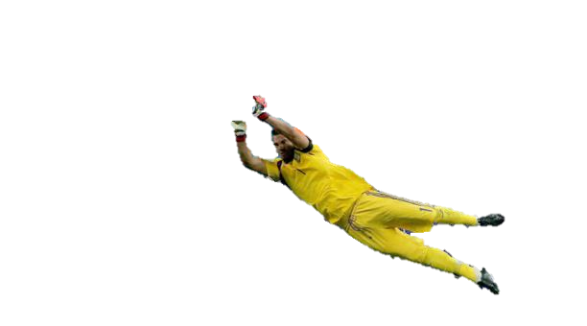

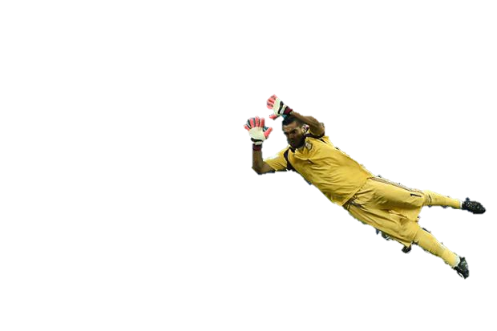

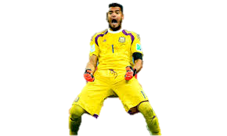

Ted's flight from Amsterdam took more than 11 hours. He ______ be exhausted.
Have to
Must
Should

Slide 3
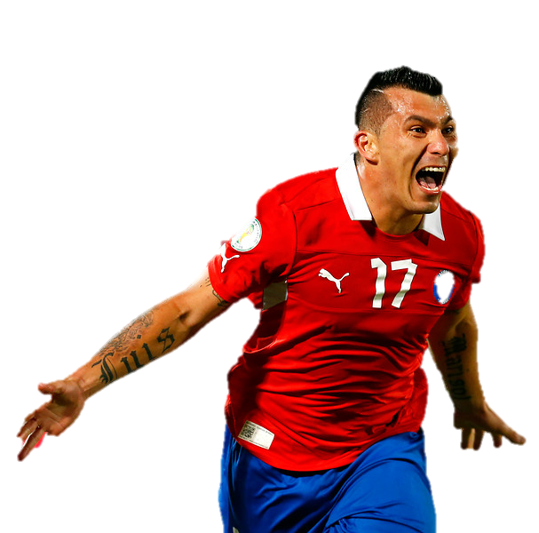
Hiking the trail to the peak _______ be dangerous if you are not well prepared for dramatic weather changes.
Might
Can
Should

Slide 4
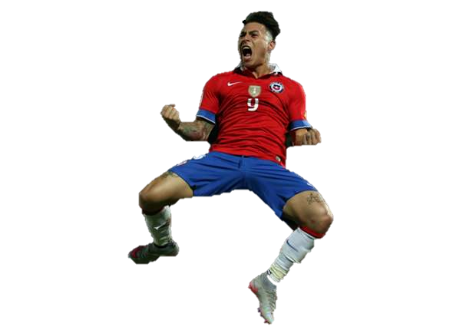
Dave: ______ you hold your breath for more than a minute?
Might
Should
Can

Slide 5
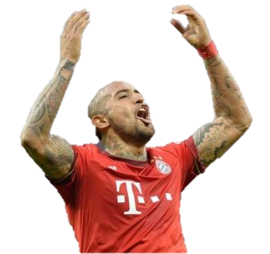
Jenny's engagement ring is enormous! It ______ have cost a fortune.
Have to
Must
Should

Slide 6
Please make sure to water my plants while I am gone. If they don't get enough water, they ______ die.
Can
Could
Must

Slide 7
I ________ speak Arabic fluently when I was a child and we lived in Egypt.
Could
Can
Should

Slide 8
The book is optional. My professor said we ________ read it if we needed extra credit.
Could
Should
Can

Slide 9
You __________ take your umbrella along with you today. It will rain.
Could
Should
Must

Slide 10
I really _________ use the bathroom!
Can
Should
Have to

Slide 11
I _________ speak Arabic fluently when I was a child and we lived in Egypt.
Could
Can
Have to

Slide 12
Ned: __________ I borrow your lighter for a minute?
Might
Can
Should

Slide 13
__________ you always say the first thing that pops into your head?
Can
Have to
Must

Slide 14
Oh no! Frank's wallet is lying on the coffee table. He _________ have left it here last night.
Could
Must
Should

